Slide 1
MCA105-Operating System

Slide 2
Agenda
Bootstrap programme
Storage types
Types of OS
Introduction to Files

Slide 3
Computer Startup
Bootstrap program is loaded at power-up or reboot
Typically stored in ROM or EEPROM, generally known as firmware
Initialize all aspects of system
Loads operating system kernel and starts execution
Bootstrap Program
OS
Read OS
OS
ROM
Load OS
Devices
RAM
Start device Drivers
MAIN MEMORY

Slide 4
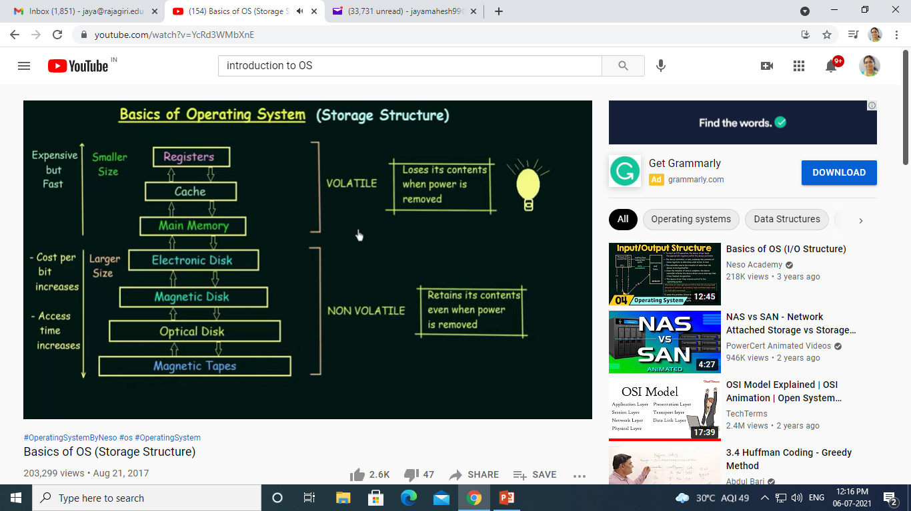

Slide 5
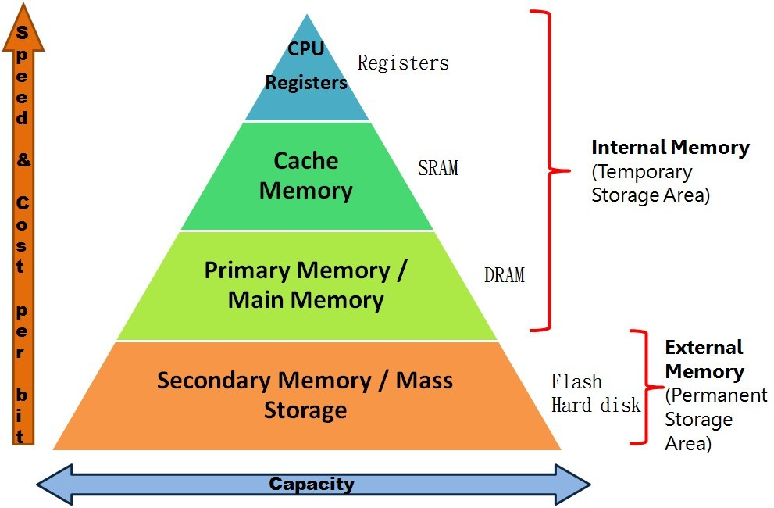


Slide 6
Caching
Important principle, performed at many levels in a computer (in hardware, operating system, software)
Information in use copied from slower to faster storage temporarily
Faster storage (cache) checked first to determine if information is there
If it is, information used directly from the cache (fast)
If not, data copied to cache and used there

Slide 7
How it works

Slide 8
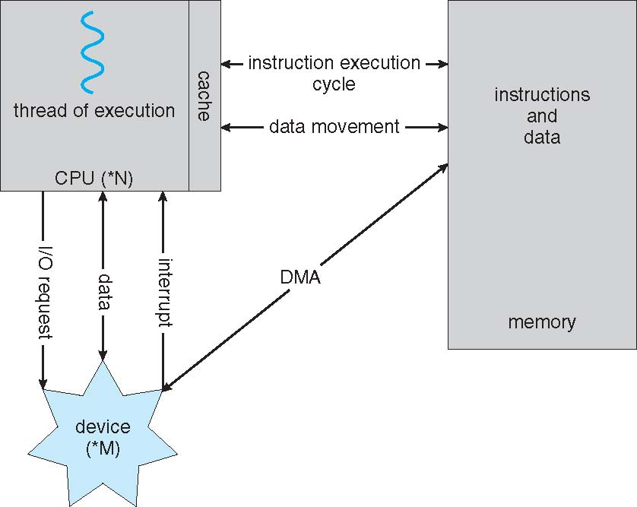
How a Modern Computer Works
A von Neumann architecture

Slide 9
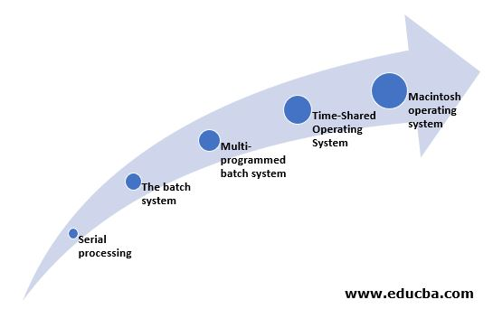
Evolution of Operating Systems

Slide 10
Different Types of Operating Systems
Batch Operating Systems
Multiprogramming Operating Systems
Multi-Tasking Operating Systems
Multi-Processing Operating Systems
Real-time Operating Systems

Slide 11
Batch Operating Systems
What do you mean by a batch?
Example of Student Batches.
In the case of OS, Batch = multiple jobs
Job = Program + Input Data + Control Instructions
Batch Operating Systems are non-interactive
User cannot directly interact with the system
User will prepare jobs in punch card and loaded into the computer with the help of an operator

Slide 12
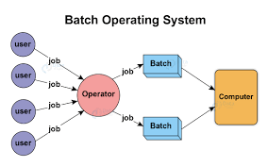

Slide 13
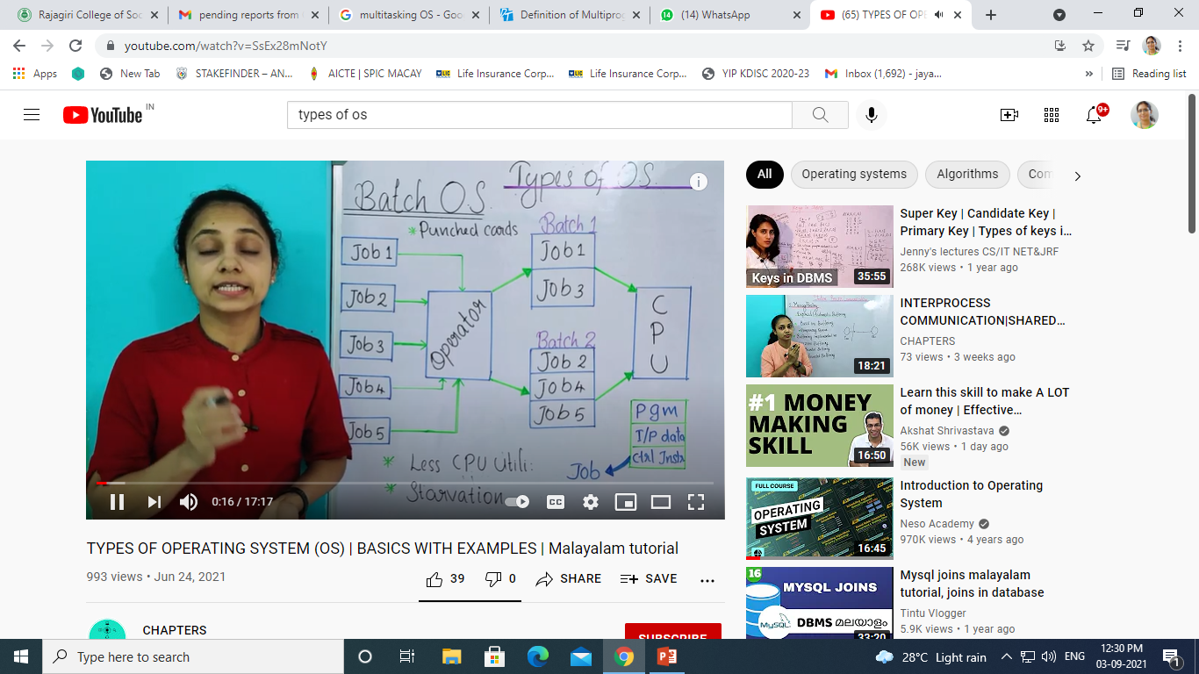

Slide 14
Multiprogramming OS
A computer running more than one program at a time (like running Excel and Firefox simultaneously).
In a modern computing system, there are usually several concurrent application processes which want to execute.
Now it is the responsibility of the Operating System to manage all the processes effectively and efﬁciently.
The Main memory is too small to accommodate all of these processes or jobs into it.
These processes are initially kept in an area called job pool

Slide 15
Multiprogramming OS
One CPU and multiple processes
CPU time will be allocated to a single process at a time
At some stages, if the admitted process needs some resources, for example, I/O devices.
Then that process will be temporarily suspended from the CPU and the CPU time will be allocated to the next process in the ready queue.
Please note that the user cannot suspend a running process and only CPU can do that.
Idle time of the CPU is minimized and the response time will be increased.

Slide 16
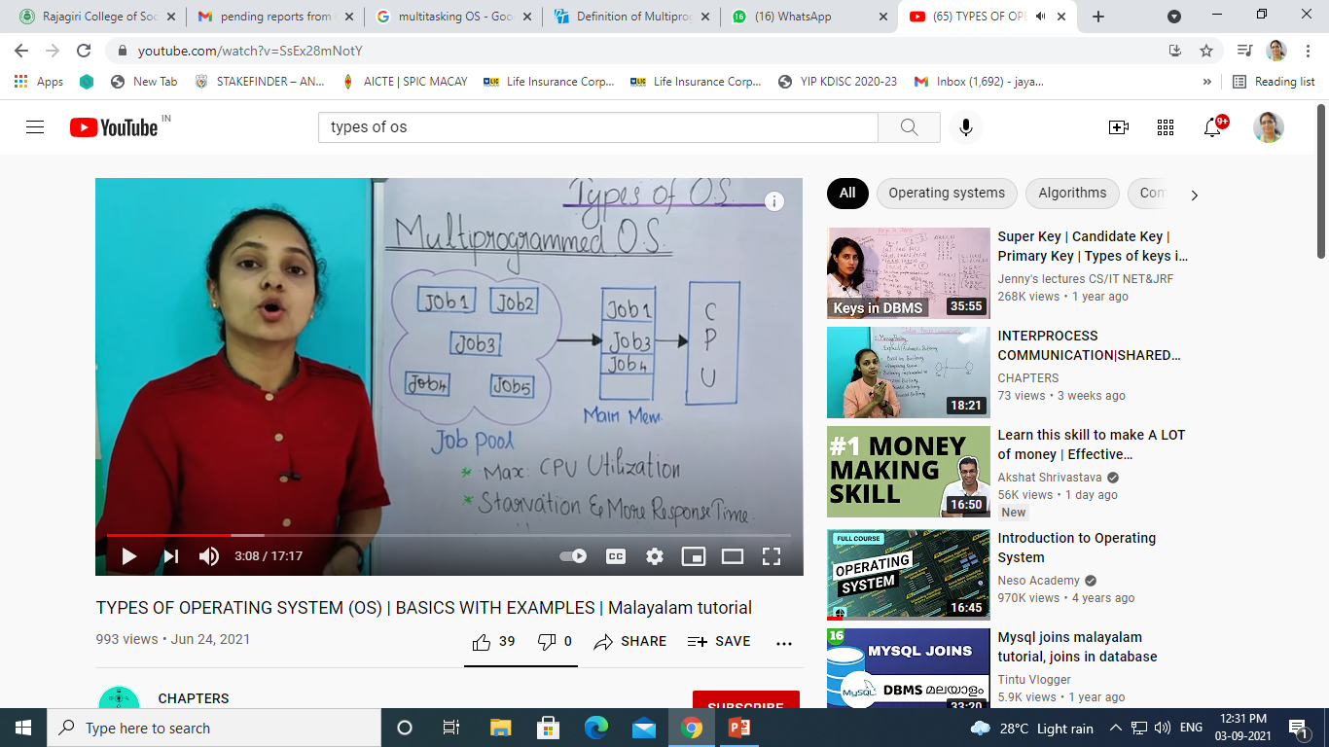

Slide 17
Multitasking OS
Multitasking OS is an extension of Multiprogramming OS
Multitasking OS is called Multiprogramming with Round Robin
Each process will get a time quantum
The process has to complete its execution within the time quantum.
If the process cannot complete its execution within the time allocated, then that process has to move out of the CPU and enter back into the ready queue
In this case, CPU will allocate the CPU time to the next process in the ready queue
With this, CPU idle time is much increased.

Slide 18
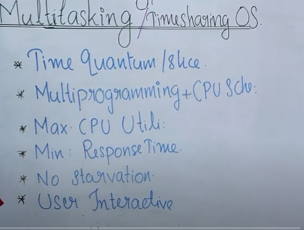

Slide 19
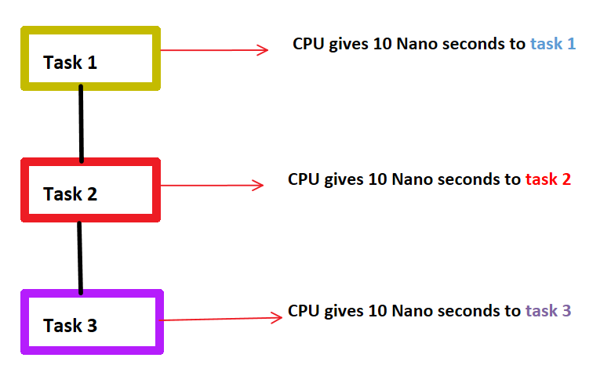

Slide 20
Multiprocessing OS
Multiple CPUs and multiple processes
Each process will be allocated to the CPU
The main advantage of multiprocessor system is to get more work done in a shorter period of time.
These types of systems are used when very high speed is required to process a large volume of data.
Multi processing systems can save money in comparison to single processor systems because the processors can share peripherals and power supplies.

Slide 21
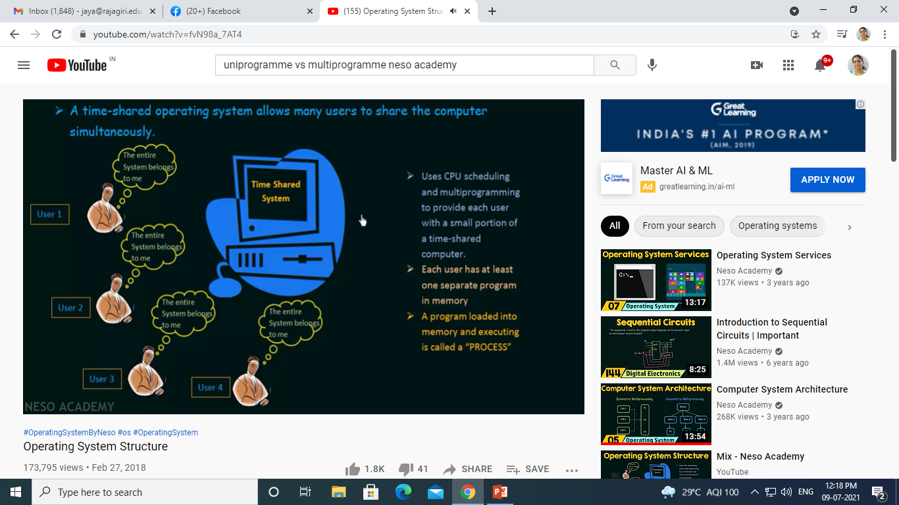

Slide 22
Real Time OS
A real-time operating system is an operating system intended to serve real-time applications that process data as it comes in, typically without buffer delays
The response time is very less as compared to other operating systems.
There are two types of Real Time OS
Hard Real Time OS
Soft Real Time OS
Hard real-time systems guarantee that critical tasks complete on time
Soft real-time systems are less restrictive. A critical real-time task gets priority over other tasks and retains the priority until it completes

Slide 23
File Systems in OS

Slide 24
What are files?
A file is a collection of related information (sequence of bits) that is recorded on secondary storage
File is a collection of logically related entities
From a user’s point of view, a file is the smallest allotment of logical secondary storage

Slide 25
File Concept
Uniform logical view of information storage (logical storage unit)
OS maps files onto physical devices
Collection of related information recorded on a secondary storage.
Smallest allotment of secondary storage Types:
Data
numeric
character
binary
Program

Slide 26
File Attributes
Name – only information kept in human-readable form
Identifier – unique tag (number) identifies file within file system
Type – needed for systems that support different types
Location – pointer to file location on device
Size – current file size
Protection – controls who can do reading, writing, executing
Time, date, and user identification – data for protection, security, and usage monitoring

Slide 27
File Management
The main objectives of the file management system are:
It provides I/O support for a variety of storage device types.
Minimizes the chances of lost or destroyed data
It provides I/O support for multiple users in a multiuser systems environment.

